Slide 1

UML – Class Diagram
Natnael Tsige
Andrew Chimbanga
Afoke Abogidi
Notes:
Hello everyone, my name is ---, I am here with Natnael Tsige and Andrew Chimbanga to present on the UML Class Diagram

Slide 2



Agenda
Modeling
UML
Class diagram
Demo code class diagram
Demo code implementation
Q and A
Notes:
To guide us through this presentation, we would discuss the concept of modeling, what UML means, we would delve into Class diagrams and then into our exercises for a class diagram followed by its code implementation.
To start us off, here is Natnael.

Slide 3
Modeling
An informative representation of an object or a system.
Notes:
So, what is modeling
It is An informative representation of an object or a system.
So, what do we mean by that?
Almost all engineering products that have model a that used to conceptualize the product that is sought to be produced. Let’s look in further detail what a modeling is.
There is two types of modeling, Physical modeling and conceptual modeling.
Physical modeling is a physical representation of an object. An example of a physical modeling can be an architectural modeling that represent any form of infrastructure for example a model of a building or Bridge.
conceptual modeling is a theoretical representation of a system. An example for conceptual modeling is market clearing or equilibrium graph which is in economics that used to show an equilibrium between supply and Demond.
The computer science aspect of modeling reside in conceptual modeling.
conceptual modeling is a representation of entities and their relationships.
So why do we need modeling? Q and A
To simplify and break down a much larger set of problem.
Helps clarify ambiguity. Helps us understand requirements better we will elaborate on those letter.
There are various molding notation in computer science such as ORM, OMT and most notably UML. For topic we will be focusing particularly on UML.

Slide 4

What is UML?
Unified modeling language is a graphic or visual representation of an application.
Is industry standard
Independent of a language.
Examples of UML
Class diagram
Domain model
Component diagram
package diagram
Use case diagram
State machine diagram
Sequence diagram
Notes:
So what is ULM?
To put it simply Unified modeling language or UML is a graphic or visual representation of an application.
Is a general-purpose, developmental, modeling language in the field of software engineering that is intended to provide a standard way to visualize the design of a system.
Is an industry standard and it is independent of a language or a platform. So what do we mean by it is independent of a language or a platform it simply means a particular UML can be implemented on any platform and it will function the same. UML is usually presented in a from of diagram. It consist mainly two types of diagram. Structural diagram and behavioral diagram . An example for Structural diagram are Class diagram, Component diagram and package diagram.
It emphasizes the things that must be present in the system being modeled. An example for behavioral diagram are Activity diagram, sequence diagram, state diagram and use case diagram.
It emphasizes what must happen in the system being modeled.
In addition, we also have domain model which is presented using class diagram to visualize a model system at its most basic form. We will elaborate on this In detail.
Each diagram represent a particular aspect of the system being modeled.
For the rest of the presentation, we will be focusing class diagram.

Slide 5
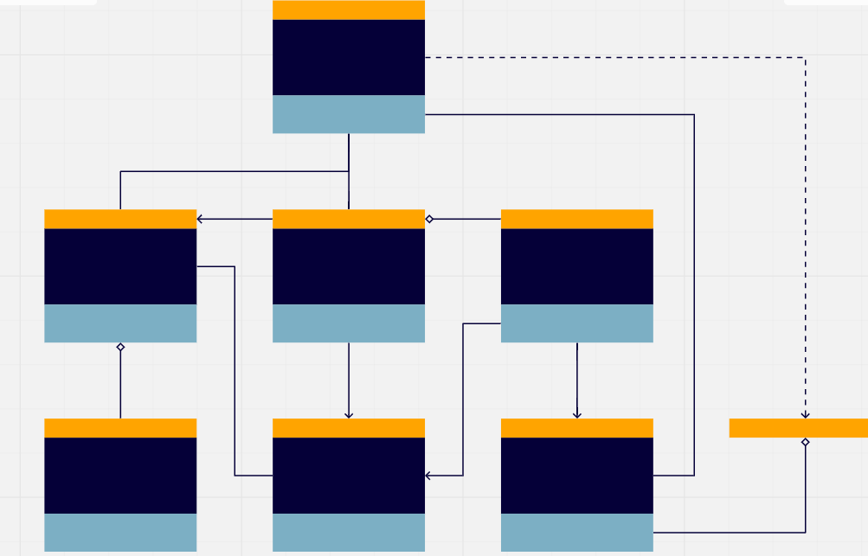
What is UML Class Diagram
A graphical notation used to construct and visualize object-oriented systems.
Specifically, a Class Diagram is a type of static structure that describes the structure of a system by showing the systems classes, their attributes, methods, and the relationships among objects.
Notes:
What is UML Class Diagram ? A graphical notation used to construct and visualize object-oriented systems.
Specifically, a Class Diagram is a type of static structure that describes the structure of a system by showing the systems classes, their attributes, methods, and the relationships among objects.
So, a ULM class Diagram has the following items in it. Classes, their attributes and methods and the relationship between classes.
Let’s look at each of the elements individually in detail.

Slide 6
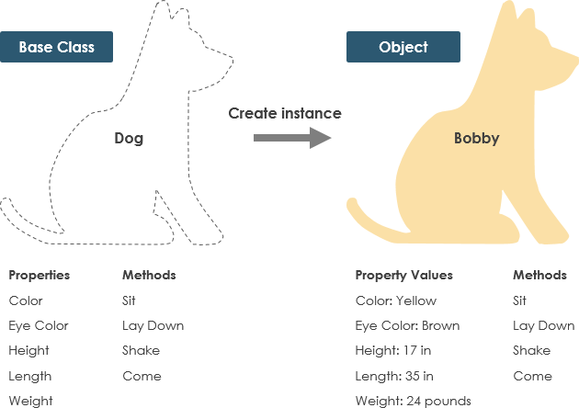
What is a class?
Blueprint of an object.
Describes what an object will be but isn’t the object itself.
Classes describe the type of objects, while objects are usable instances of classes.
An object is an instance of a class and object – Objects have states and behaviors.
A dog has states – color, name, breed as well as behaviors
Notes:
Let’s start with a class as it the essential element of the class diagram. As the name implies a class diagram need a class.
So, what is class? Q and A for students.
It’s a blueprint of an object. Object and classes go hand in hands. Classes are what create objects.
it Describes what an object will be but isn’t the object itself.
So what do we mean by that?
Let’s look at the illustration in the presentation. Here we have a base class dog. This can be a reference to an dog, where as Bobby is a particular instances dog that exabits all the characteristics of a dog (which is the class) with a particulate state and behavior like having a yellow color and a brown eye.
Each object is built from the same set of blueprints and therefore contains the same components (properties and methods.)
This mean another instance of a dog lets all him Charlie will also have a color, a height and all the other properties and methods the base class dog have.
Classes describe the type of objects, while objects are usable instances of classes.
An object is an instance of a class and object – Objects have states and behaviors

Slide 7
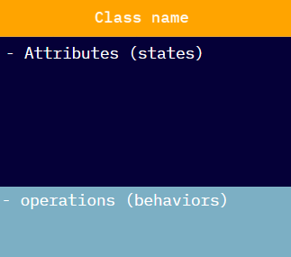
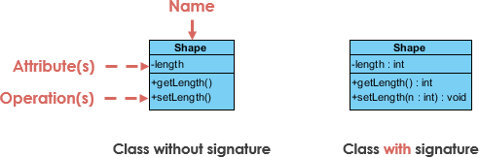
UML Class Notation
A class represents a concept which encapsulates state (attributes) and behaviors (operations).
Each attribute has type.
Each operation has a signature.
In a class diagram, the class name is the only mandatory information.
Two types of classes.
Notes:
Now that we defined class, what does a class notation looks like in class diagram.

Slide 8
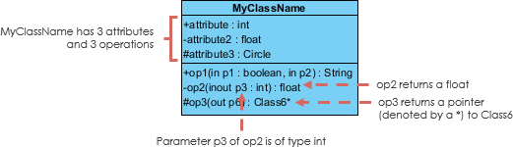
UML Class Notation cont.
Class name appears in the first partition
Class Attributes, shown in second partition, map onto member variables (data members) in code.
Class Operations are shown in the third partition.
The return type is shown after the colon at the end of the method signature.
The return type of method parameters are shown after the colon following the parameter name.
Notes:
Class name appears in the first partition. In the case abstract class, the class name is italicized to imply the class is abstract. Class Attributes, shown in second partition, map onto member variables (data members) in code.
Attribute type is shown after the colon. Those will represent a data type of the Attribute. Class Operations are shown in the third partition. They are the services the class provides.
The return type of method parameters are shown after the colon following the parameter name. Operations map onto class methods in code
I will elaborate What the +,-,# and ~ tilde signs in the next slide.

Slide 9
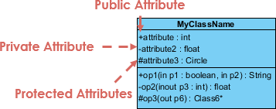
Class Visibility
Classes, member variables, and methods can have access modifiers describing the Object-oriented principle of Encapsulation.
The +, - and the # symbols before an attribute and operation name in a class denote the visibility of the attribute ad operation.
Modifier | Symbols | Description
Public | + | Accessible for all elements within the namespace.
Private | - | Accessible for all elements within the class.
Protected | # | Accessible for all classes that inherited the class its declared in.
Internal | ~ | Accessible within the entire scope of the Assembly (project)
Notes:
Classes, member variables, and methods can have access modifiers describing the Object-oriented principle of Encapsulation.
The +, - and the # symbols before an attribute and operation name in a class denote the visibility of the attribute ad operation.

Slide 10
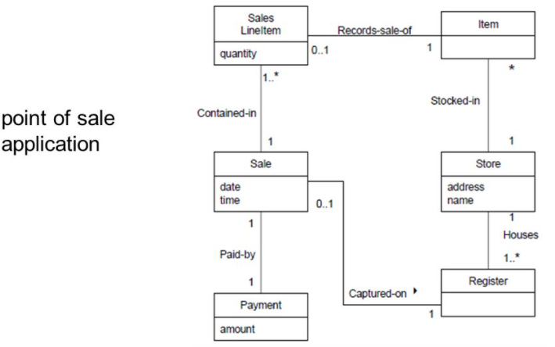
Class Diagrams vs Domain Models
Domain models are conceptual while class diagrams are both conceptual logical (Solution-independent)
Domain model classes show only important attributes with no methods
Domain models like class diagrams are platform independent.
Attributes do not have data types specified.
Notes:
Now let's revisit Domain model. We stated earlier domain model is presented using class diagram to visualize a model system at its most basic form. Now that we have seen what class is let’s make a comparison between class diagram and domain model.
Domain models are conceptual while class diagrams are both conceptual logical (Solution-independent)
Domain model classes show only important attributes with no methods.
Attributes do not have data types specified in domain model.
While there are very similar there a few future that distinguish them from each other.
Let’s revisit the point sale application from our class to illustrate the difference. Most notable difference here is there are only tow boxes in class. That is because in domain model we don’t specify properties, another notable difference here is that we also don’t have access modifiers for the attributes whereas in class we do.

Slide 11
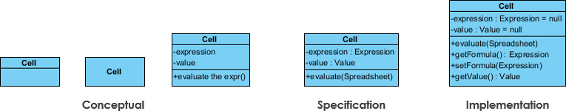
Perspectives of Class Diagrams cont.
Conceptual: represents the concepts in the domain
Specification: focus is on the interfaces of Abstract Data Type (ADTs) in the software
Implementation: describes how classes will implement their interfaces
Notes:
So which do we use to model our system.
Perspectives of Class Diagrams
Choice of perspective depends on how far along you are in the development process.
Domain model: is best used during its formulation, for example, you would seldom move past the conceptual perspective.
Analysis models will typically feature a mix of conceptual and specification perspectives.
Design model development will typically start with heavy emphasis on the specification perspective and evolve into the implementation perspective.

Slide 12
Importance
UML precisely conveys how code should be implemented from diagrams when it is used correctly.
If precisely interpreted, the implemented code will correctly reflect the intent of the designer.
Notes:
What are the importance of using UML aside what we have mention at the begin of the presentation.
UML precisely conveys how code should be implemented from diagrams when it is used correctly.
If precisely interpreted, the implemented code will correctly reflect the intent of the designer.
Any question?
So now that we have seen the class element of class diagram, now I will pass the mic on to Afoke, to explain the relationship aspect of class diagram.

Slide 13
Relationships Between Classes
Classes can relate to each other in a variety of ways.
Examples of relationships
Association
Inheritance (Generalization)
Multiplicity
Aggregation
Composition
Dependency
Realization
Notes:
Classes can be related to each other in several ways.
Here is a list showing the different types of relationships classes can have.
We would go through each one of them in the next couple of slides.

Slide 14
Association
An association represent any logical connection between classes.
Association is symbolized by a line.
An association can be;
Directed
Reflexive
Passengers
Airline Staff
Airplane
Reflexive: Shows multiple functions or responsibilities
Directed: Container-contained directional flow
Notes:
An association is a broad term that encompasses any logical relationship between classes.
In the example seen here, a passenger and an airline are linked. This is shown by just a simple straight line from one class to the other. An association can be reflexive or directed.
A reflexive association as seen here occurs when a class has multiple functions. With the example of a staff member of an airline, he/she may be a pilot, guard, maintenance engineer etc.
Directed association occurs when there is a directional flow of classes. Having the container-contained relationship.
In our example here, an airplane contains passengers.

Slide 15
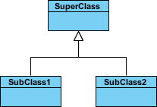
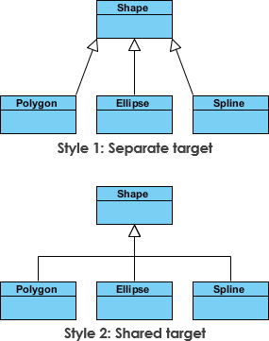
Inheritance (or Generalization)
A generalization is a taxonomic relationship between a more general classifier and a more specific classifier.
Each instance of the specific classifier is also an indirect instance of the general classifier. Thus, the specific classifier inherits the features of the more general classifier.
Represents an "is-a" relationship.
An abstract class name is shown in italics.
SubClass1 and SubClass2 are specializations of Super Class.
Notes:
Inheritance or Generalization is a type of relationship which occurs when an associated class is a child of another by virtue of assuming the same functionalities of the parent class.
This relationship can also be described as an “is-a” relationship and here are some examples.
SubClass1 is a child class of Superclass. So also, for subclass2.
Both subclasses are a more specialized form of Superclass.
To show inheritance relationship, a solid line from the child class to the parent class is drawn using an unfilled arrow-head.

Slide 16
Inheritance cont.
In order to avoid redundancy in our program it’s a good practice to generalize certain states and behaviors some classes may share in a single class and the instance of these classes can inherit those states and behaviors.
Symbolized by
<<BankAccount>>
owner: balance
+ deposit + withdrawal
SavingsAccount
annualInterestRate
+ processCheck
CheckingAccount
InsufficientFundFee
+ depositMonthlyInterestRate
Notes:
Inheritance relationships are useful in order to avoid redundancy in program implementations.
It is a good practice to generalize certain states and behaviors that some classes may share in a single class, and the instance of these classes can inherit those states and behaviors. The inheritance relationship is shown as a solid line with a filled in arrow-head. In this example Savings account and Checking accounts both inherits from Bank Account.

Slide 17
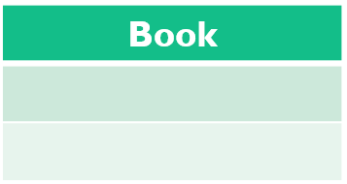
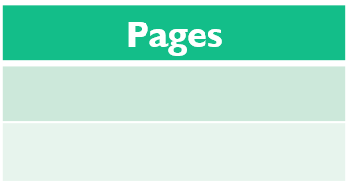
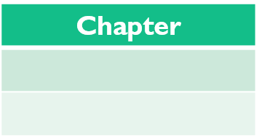
Multiplicity (Cardinality)
This association relationship is used to show the cardinality of a class in relation to another class.
For example, a book can have more than 1 pages and more than 0 chapters.
0..* denotes “zero to many” and 1..* denotes “1 to many”
1 …*
0 …*
Notes:
Cardinality indicates the number of instances of one class linked to one instance of the other class.
For example, one company will have one or more employees, but each employee works for just one company.
Another example is the pages to book or chapters to book relationship seen here. One book can have many chapters.
Cardinality is expressed in terms of:
One to one
One to many
Many to many
Is there another potential relationship that can be seen from this example on the slide? Yes, pages can be related to Chapters in a multiplicity relationship. In this case one chapter can have many pages 1 …* relationship.

Slide 18
Aggregation
Aggregation is another association relationship in UML Class diagrams.
An aggregation relationship can be described in simple words as “an object of one class can own or access the objects of another class.
In an aggregation relationship, the dependent object remains in the scope of a relationship even when the source object is destroyed.
Symbolized by
The relationship is displayed as a solid line with an unfilled diamond at the association end.
Wolf
Pack
Notes:
Aggregation is a special type of association. Here, a child can exist independently of the parent
It represents a "part of" relationship.
Like students(child class) is a part of Class (parent class)
Another good example showing aggregation is the one seen on the slide with wolf as the child class and the pack of wolves as the parent class.
Objects of the wolf class and the pack of wolves' class have separate lifetimes and can exist independently.

Slide 19
Composition
Composition is another type of association relationship in UML.
In a composition relationship, objects that are associated with each other cannot remain in the scope without each other.
Symbolized by
The relationship is displayed as a solid line with a filled diamond at the association end, which is connected to the class that represents the whole or composite.
Book
Pages
Chapter
Notes:
Composition is a different type of relationship where parts are destroyed when the whole is destroyed.
In this relationship, there is some level of dependency on the parent class.
The parent class is composed of the child classes.
For example;
Pages and Chapter objects live and die with Book object.
Pages cannot stand by itself, and chapters cannot also stand by itself
The relationship is displayed as a solid line with a filled diamond head at the association end, which is connected to the class that represents the whole or composite.

Slide 20
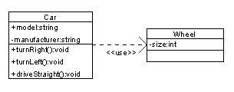
Dependency
An object of one class might use an object of another class in the code of a method. If the object is not stored in any field, then this is modeled as a dependency relationship.
A special type of association.
Exists between two classes if changes to the definition of one may cause changes to the other (but not the other way around).
Class1 depends on Class2
The relationship is displayed as a dashed line with an open arrow.
Notes:
Dependency is another type of UML class diagram relationship that shows that an element, or set of elements, requires other model elements for their specification or implementation.
The element is dependent upon the independent element, called the supplier.
This relationship is also called the supplier-client relationship
In our example of the screen, the car class uses the wheel.
The relationship is displayed as a dashed line with an open arrow.

Slide 21
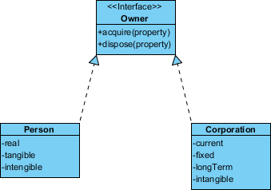
Realization
Realization is a relationship between the blueprint class and the object containing its respective implementation level details. This object is said to realize the blueprint class. In other words, you can understand this as the relationship between the interface and the implementing class.
For example, the Owner interface might specify methods for acquiring property and disposing of property. The Person and Corporation classes need to implement these methods, possibly in very different ways.
Notes:
Realization is another relationship type in UML class diagrams. It shows the relationship between a blueprint class and the class with the implementation level details which does the actual implementation.
The object which implements the blueprint class is said to have realized the blueprint class.
This is seen in a relationship between a printer setup configuration class and the printer class.
While the printer setup class configures how the printer would work, the printer does the printing using the specifications provided by the setup class.
Another example is the one we see here, where the owner interface specifies how to acquire and dispose of properties, but the actual implementation is done by the person and the cooperation classes.

Slide 22
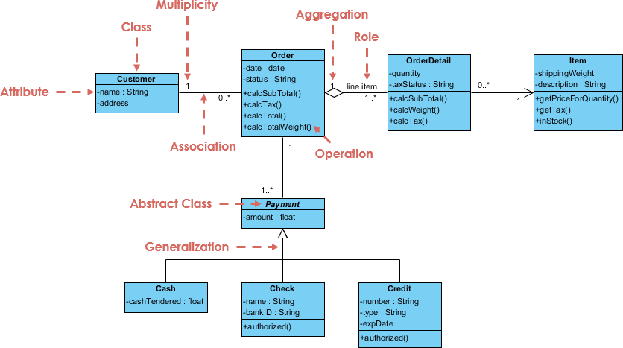
Class Diagram Example: Order System
Notes:
Next, we have an example class diagram showing different relationships.
We can see Multiplicity, which shows our cardinalities.
We can see aggregation and generalization relationships.
The payment class is an abstract class that the different payment types of cash, check and credit can derive from.
We also see the general structure of the class, showing the class name, its attributes as well as its methods.

Slide 23

This Photo by Unknown Author is licensed under CC BY-NC
Notes:
Are there any questions about the different types of relationships we have discussed? I will now pass it on to Andrew to talk about our Class exercise.

Slide 24
Exercise
You are contracted be Goldman Sachs to implement an ATM software that will process customer transactions. Additionally, they would like be shown a well detailed class diagram prior to the software’s implementation. How would you go about this?
What classes would you need?
What type of relationships would exist between these classes?
How would you construct the class diagram?
Notes:
The first thing is to understand what your client is asking for?
What are the core services that an ATM provides?????
Withdrawal
Deposit
Check balance
What key objects does an ATM transact with?
Bank Account

Slide 25
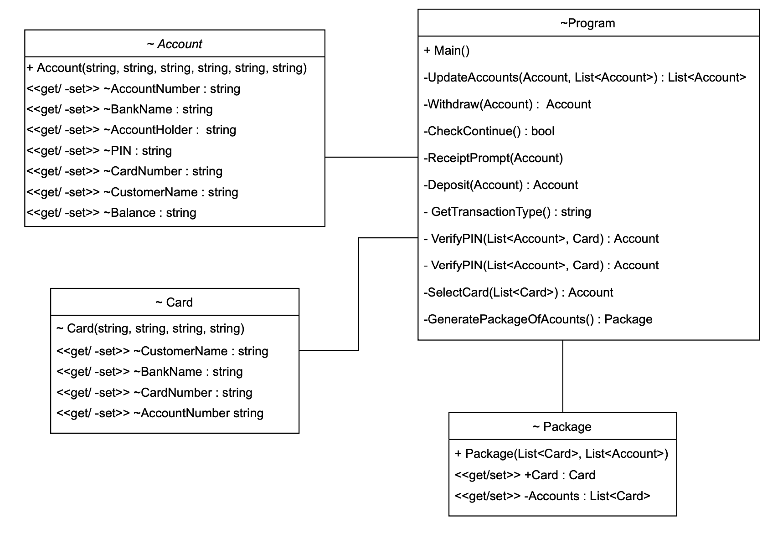
ATM Application
Notes:
Upon thinking about this, I went straight into implementing an ATM application without any thought given towards creating a class diagram. This is a mistake made often by junior engineers like myself. Here is what I ended up with.
While this program runs and functions, I found it extremely hard to determine the relationships between the classes. Furthermore, I found that this design assumes that the only way to access a person’s account info is by using a debit or ATM card. The design itself couldn’t easily be altered to incorporate the fingerprint nor retina scan authentication.
What GRASP principles are not followed here? To name a few:
There is High coupling in the program class (which represents the ATM) and low cohesion
High coupling in the sense that program generates the accounts and also verifies the pins. These should be handled by a different classes.
Protected variation pattern isn’t followed as there are primarily two types of accounts that an ATM transacts with. Namely checking and savings account. This current design only creates one type of account.
The one good thing I have going on with this diagram is that the signatures are highly detailed. This detail also exposes a security risk. Can anyone see what it is?
The relationship between account and program isn’t specified. To make it worse, an account is public so it can be created by any class outside of the assembly. Furthermore, the properties have private setters meaning that you can modify all the subsequent fields. Most of these should be read only
Same goes with card class. I shouldn’t be able to change any of the fields of the card. These too should be read only.
And what is package class? While know what it represents, the next engineer to inherit my code would be hard pressed to easily figure out what package is, let alone what package does. Hence, proper detailed naming convention was followed here.
By the way, the package class represents a class that generates a list of accounts and debit cards, and returns them both as lists, wrapped in a “package class”. This was my work around of returning multiple lists. But this type of implementation means that I could never generate an account by itself without having a card attached to it, as vice versa.
These problems are just some of the issues that I could have avoided had I properly followed GRASP principles and designed a class diagram before jumping straight to coding.

Slide 26
ATM Application Demo
Notes:
Just to show that functional code doesn’t mean its properly implemented, here is the previous class diagram implemented………

Slide 27
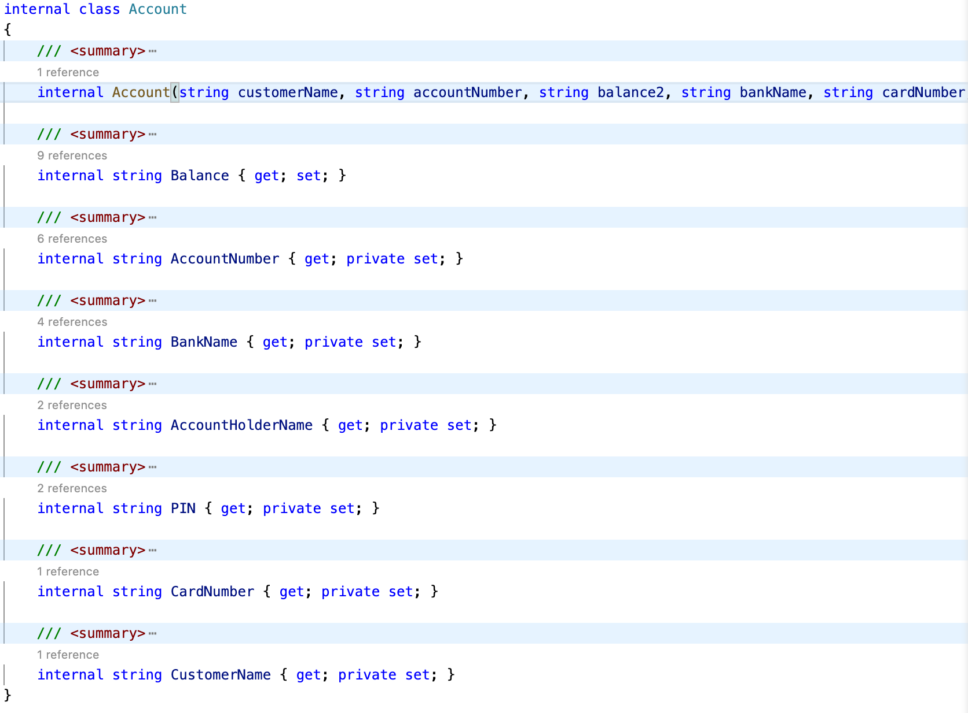
ATM Application
Notes:
There are some obvious issues here. When you look at the account class on the left, you can see that the arrangement isn’t correct. The properties are not methods. They simply read, write, or compute the value of a private field as if it were a public data. They need to be in the section between the class name and the operator section. You will also notice that Account method in the diagram isn’t an accurate reflection of the actual method that's implemented in the code. Class diagrams need to be followed explicitly for them to work as designed. Other wise what is the use.

Slide 28
ATM Application
Notes:
The question now becomes “how could we better implement this class diagram to achieve a better, more secure design?”

Slide 29
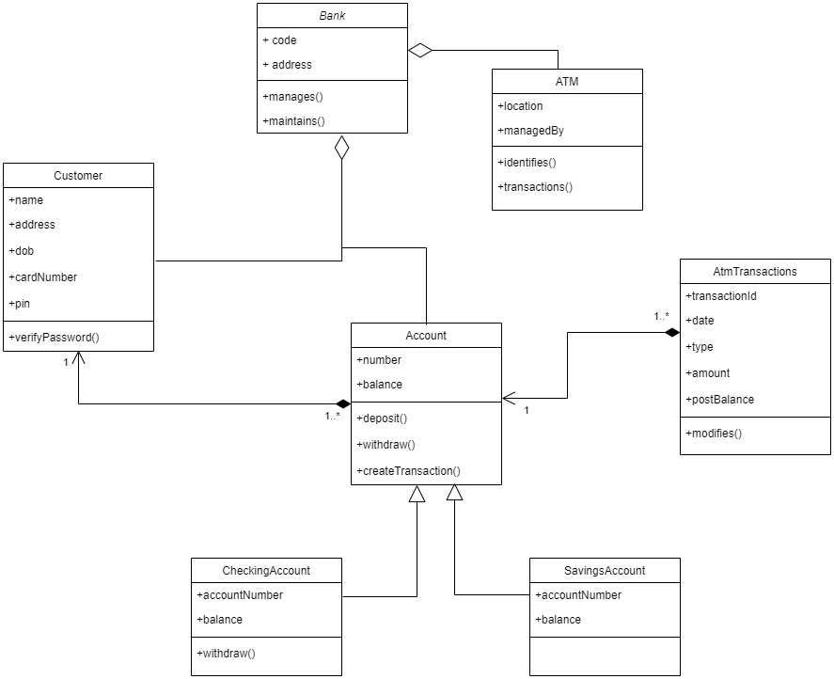
Better Class Diagram
Notes:
Here we can notice that relationships between classes now specify how they’re are related, in addition to addressing the low coupling, high cohesion problem of the previous diagram.
An aggregate relationship is shown between an ATM and the bank class. This shows that an object of the ATM class can own or access the objects of bank class. Additionally, the dependent object of this relationship remain even when the source object is destroyed. That’s to say that we don’t go riding ourselves of all the ATM’s when a bank closes.
This same relationship exists between the customer and bank, and the account and bank.
Two relationships are shown between the account and the customer classes:
Aggregation from customer to account shows that a customer can have 1 or many accounts
Directed association is shown from account to customer denoting that an account can have at most one customer.
This same paired relationships are shown between atm transaction and account classes to show that an account can have one or more AtM transactions, whereas an ATM transaction can only be directly linked to one account.
Inheritance is shown between the checking account and account class and savings account and account class. This shows that the checking and saving account classes inherit all the features of their parent Account class.
Implementing this class diagram as shown would result in a better implementation of the original problem that we presented.

Slide 30
Q and A

Slide 31

Summary
Notes:
So to wrap things up…
Class diagrams describe systems by illustrating attributes, operations and relationships between classes. Unified Modeling Language (UML) calls them structure diagrams. They work according to the principles of object orientation. This orientation describes how objects interact with each other.
Class is a term for the collective structure and the combined behavior of objects (classification). In other words: objects are included in a class if they have similar properties – i.e. the mutual properties in specific objects are grouped into a single class.
Class diagrams give you the ability to create models with the help of UML using attributes, relationships, operations and intersections. A class diagram visualizes the paths between classes in the form of aggregations and associations as well as through the passing on of properties and behavior between classes. These take the form of generalizations.
Class diagrams are also the most important kind of UML diagram and are vitally important in software development. They are the best way to illustrate a system’s structure in a detailed way, showing its attributes, operations as well as its inter-relationships. Classes play a significant role in object orientated programming languages as they are indispensable when it comes to software modelling.
Lastly, class diagrams are at the heart of UML. They are based on the principles of object orientation (aka GRASP) and can be implemented in various phases of a project. During the analysis they appear as the domain model where they attempt to create a representation of reality. During the design phase, the class diagram is used to model software, and during the implementation phase it can be applied to generate source code. Class diagrams are a vital part of any software development project and they form the foundation of all software products.
Thank you so much.

Slide 32
References
https://www.lucidchart.com/pages/uml-class-diagram
https://courses.cs.washington.edu/courses/cse403/11sp/lectures/lecture08-uml1.pdf

Slide 33


Thank You

